Slide 1



Java Swing
Chris North
cs3724: HCI

Slide 2
AWT to Swing
AWT: Abstract Windowing Toolkit
    import java.awt.*
Swing: new with Java2
    import javax.swing.*
    Extends AWT
    Tons o’ new improved components
    Standard dialog boxes, tooltips, …
    Look-and-feel, skins
    Event listeners
API:
    http://java.sun.com/j2se/1.3/docs/api/index.html

Slide 3
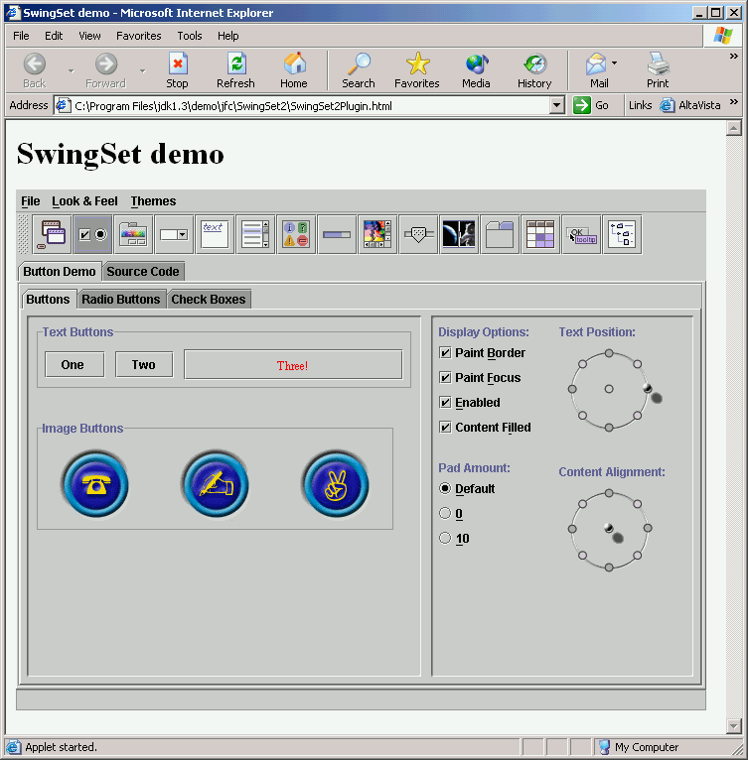
Swing Set Demo
J2sdk/demo/jfc/SwingSet2
Many predefined
GUI components

Slide 4
GUI Component API
Java: GUI component = class
Properties
Methods
Events
JButton

Slide 5
Using a GUI Component
Create it
    Instantiate object: b = new JButton(“press me”);
Configure it
    Properties: b.text = “press me”; [avoided in java]
    Methods: b.setText(“press me”);
Add it
    panel.add(b);
Listen to it
    Events: Listeners
JButton

Slide 6
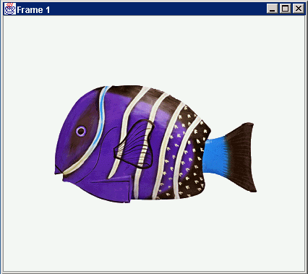
Anatomy of an Application GUI
GUI
Internal structure
JFrame
JFrame
JPanel
containers
JPanel
JButton
JButton
JLabel
JLabel

Slide 7
Using a GUI Component 2
Create it
Configure it
Add children (if container)
Add to parent (if not JFrame)
Listen to it
order
important

Slide 8
Build from bottom up
Create:
    Frame
    Panel
    Components
    Listeners
Add: (bottom up)
    listeners into components
    components into panel
    panel into frame
Listener
JLabel
JButton
JPanel
JFrame

Slide 9
Code
JFrame f = new JFrame(“title”);
JPanel p = new JPanel( );
JButton b = new JButton(“press me”);
p.add(b); // add button to panel
f.setContentPane(p); // add panel to frame
f.show();
press me

Slide 10
Application Code
import javax.swing.*;
class hello {
public static void main(String[] args){
JFrame f = new JFrame(“title”);
JPanel p = new JPanel();
JButton b = new JButton(“press me”);
p.add(b); // add button to panel
f.setContentPane(p); // add panel to frame
f.show();
}
}
press me

Slide 11
Layout Managers
Automatically control placement of components in a panel
Why?

Slide 12
Layout Manager Heuristics
null
FlowLayout
GridLayout
none,
programmer
sets x,y,w,h
Left to right,
Top to bottom
BorderLayout
CardLayout
GridBagLayout
n
c
One at a time
w
e
JButton
s

Slide 13
Combinations
JButton
JButton
JTextArea

Slide 14
Combinations
JButton
JButton
JFrame
n
JPanel: BorderLayout
c
JPanel: FlowLayout
JTextArea

Slide 15
Code: null layout
JFrame f = new JFrame(“title”);
JPanel p = new JPanel( );
JButton b = new JButton(“press me”);
b.setBounds(new Rectangle(10,10, 100,50));
p.setLayout(null); // x,y layout
p.add(b);
f.setContentPane(p);
press me

Slide 16
Code: FlowLayout
JFrame f = new JFrame(“title”);
JPanel p = new JPanel( );
FlowLayout L = new FlowLayout( );
JButton b1 = new JButton(“press me”);
JButton b2 = new JButton(“then me”);
p.setLayout(L);
p.add(b1);
p.add(b2);
f.setContentPane(p);
Set layout mgr before adding components
press me
then me

Slide 17
Applets
JApplet
JApplet is like a JFrame
Already has a panel
    Access panel with JApplet.getContentPane( )
import javax.swing.*;
class hello extends JApplet {
public void init(){
JButton b = new JButton(“press me”);
getContentPane().add(b);
}
}
contentPane
JButton

Slide 18
Applet Methods
Called by browser:
init( ) - initialization
start( ) - resume processing (e.g. animations)
stop( ) - pause
destroy( ) - cleanup
paint( ) - redraw stuff (‘expose’ event)

Slide 19
Application + Applet
import javax.swing.*;
class helloApp {
public static void main(String[] args){
// create Frame and put my mainPanel in it
JFrame f = new JFrame(“title”);
mainPanel p = new mainPanel();
f.setContentPane(p);
f.show();
}
}
class helloApplet extends JApplet {
public void init(){
// put my mainPanel in the Applet
mainPanel p = new mainPanel();
getContentPane().add(p);
}
}
// my main GUI is in here:
class mainPanel extends JPanel {
mainPanel(){
setLayout(new FlowLayout());
JButton b = new JButton(“press me”);
add(b);
}
}
Command line
Browser
JFrame
or
JApplet
contentPane
JPanel
JButton

Slide 20
Applet Security
No read/write on client machine
Can’t execute programs on client machine
Communicate only with server
“Java applet window” Warning

Slide 21
In JBuilder

